Slide 1
Lecture: 04
Laplace Transform of Continuous-time Signals & Systems
By
Afrin Ahmed

Slide 2
Laplace Transform
The Laplace transform is an extremely useful mathematical tool in the analysis and design of continuous-time LTI systems.
It is used to convert time-domain signal into the s-domain, where s is a complex variable called Laplace operator.
The power of the Laplace transform is in converting linear differential equations with constant coefficients into algebraic equations which are easier to solve.
By converting signal into s-domain, we can avoid using the convolution integral by simply multiplying the transformed quantities in the s-domain.

Slide 3
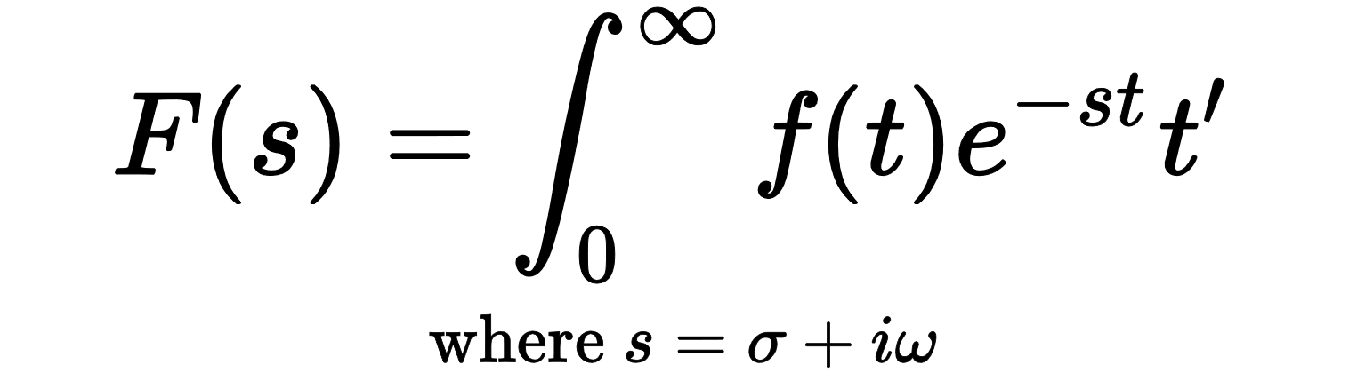
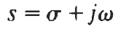
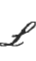
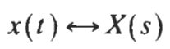
Laplace Transform
For a general continuous-time signal f(t), its Laplace transform F(s) is defined as
The variable s is generally complex-valued and is expressed as
(with real part σ and imaginary part ω)
The Equation is sometimes considered an operator that transforms a signal f(t) into a function F(s) symbolically represented by
F(t) = f(t)
The signal x(t) and its Laplace transform X(s) are said to form a Laplace transform pair denoted as

Slide 4
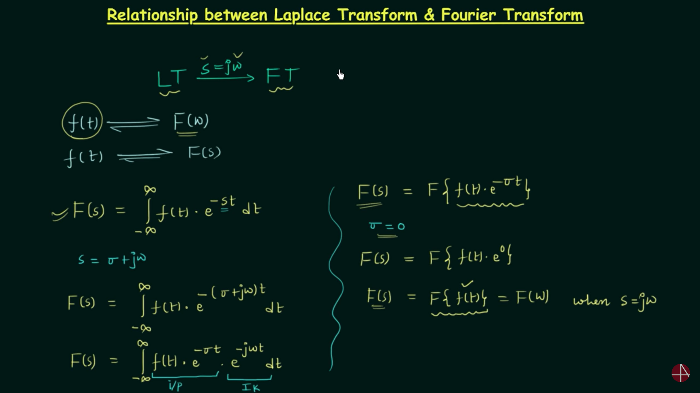

Slide 5
Laplace Transform vs Fourier Transform
Laplace Transform | Fourier Transform
The Laplace transform of a function x(t) can be represented as a continuous sum of complex exponential damped waves of the form e^{st}. | The Fourier transform of a function x(t) can be represented by a continuous sum of exponential functions of the form of e^{jωt}.
The Laplace transform is applied for solving the differential equations that relate the input and output of a system. | The Fourier transform is also applied for solving the differential equations that relate the input and output of a system.
The Laplace transform can be used to analyze unstable systems. | Fourier transform cannot be used to analyze unstable systems.
Laplace Transform does not require that the function is defined for a set of negative real numbers. | Fourier Transform is only defined for functions that are defined for all real numbers.
Laplace transform exists for every function with a Fourier Transform. | On the other hand, it is not always true that every function with a Laplace Transform has a Fourier Transformer.
The Laplace transform is widely used for solving differential equations since the Laplace transform exists even for the signals for which the Fourier transform does not exist. | The Fourier transform is rarely used for solving the differential equations since the Fourier transform does not exists for many signals. For example |x(t)| as it is not absolutely integrable.
The Laplace transform has a convergence factor and hence it is more general. | The Fourier transform does not have any convergence factor.
The Laplace transform of a signal x(t) is equivalent to the Fourier transform of the signal x(t)e^{-σt}. | The Fourier transform is equivalent to the Laplace transform evaluated along the imaginary axis of the s-plane.

Slide 6
Forms of Laplace Transform
Signals and systems use two forms of Laplace transform (LT):
Unilateral (one-sided) Laplace transform
Bilateral (two-sided) Laplace transform
If the type of Laplace transform is not specified, it can be assumed that you should calculate the unilateral version.

Slide 7
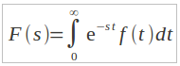
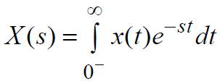
Forms of Laplace Transform
Unilateral (one-sided) Laplace transform:
The one-sided LT accepts one-sided signal whose extent is infinite for either t < 0 or t > 0.
One-sided LT can not work with both causal and non-causal system models;
A unilateral Laplace transform is defined as:
For a right-sided, or unilateral, signal x(t), sometimes written as x(t)u(t) to emphasize that the signal is zero for t<0, the unilateral Laplace transform is defined as
Here s is a complex variable, often written in rectangular form using the standard notation s =σ + jω.
If the type of Laplace transform is not specified, it can be assumed that you should calculate the unilateral version.

Slide 8
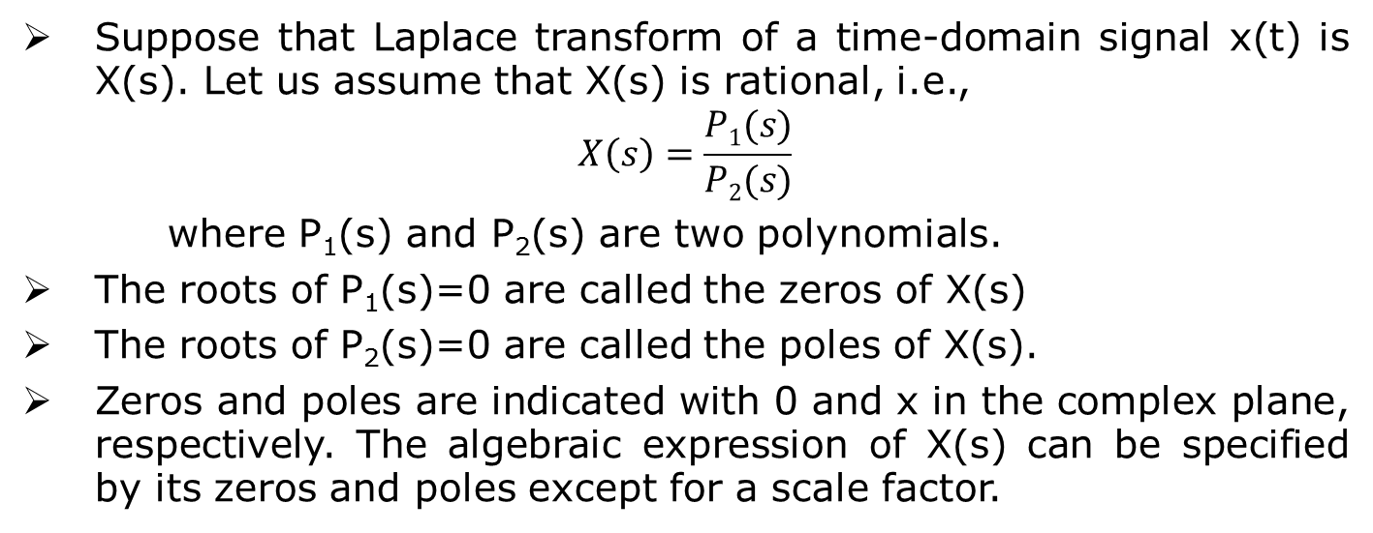
Zeros and Poles of Laplace Transform
If we can find the zeros and poles of X(s), we can get a general idea of what the waveform f(t) will look like.
For example, if the roots (poles and zeros) are real, then the waveform is exponential. If they’re imaginary, then it is a combination of sines and cosines. And if they are complex, then its is a damping sinusoid.

Slide 9
Condition for existence of Laplace Transform
The necessary and sufficient conditions for the existence of the Laplace transform are −
The function x(t) should be piece-wise continuous in the given closed interval and must be of exponential order.
The function x(t)e^{-st} should be integrable
Input function can have non- integrable part combined with integrable ones.

Slide 10
Region of Convergence (ROC)
Not all functions (signals) possess a Laplace transform and those that have Laplace transform is often limited to a region of the so-called s-plane defined by the real axis (σ) versus the imaginary axis (jω), referred to as the region of convergence (ROC).
It is the range of complex variables s in s-plane for which the equation of Laplace transform is finite or convergent.
Thus, the Laplace transform has two parts- the expression and the region of convergence respectively. The region of convergence of the Laplace transform is essentially determined by Re(s).
The ROC in general gives us an idea of the stability of a system and is also a representation of the poles-zero plot of a system. It is essential to note that the ROC never includes poles.
To illustrate the Laplace transform and the associated ROC, let us consider some examples.

Slide 11
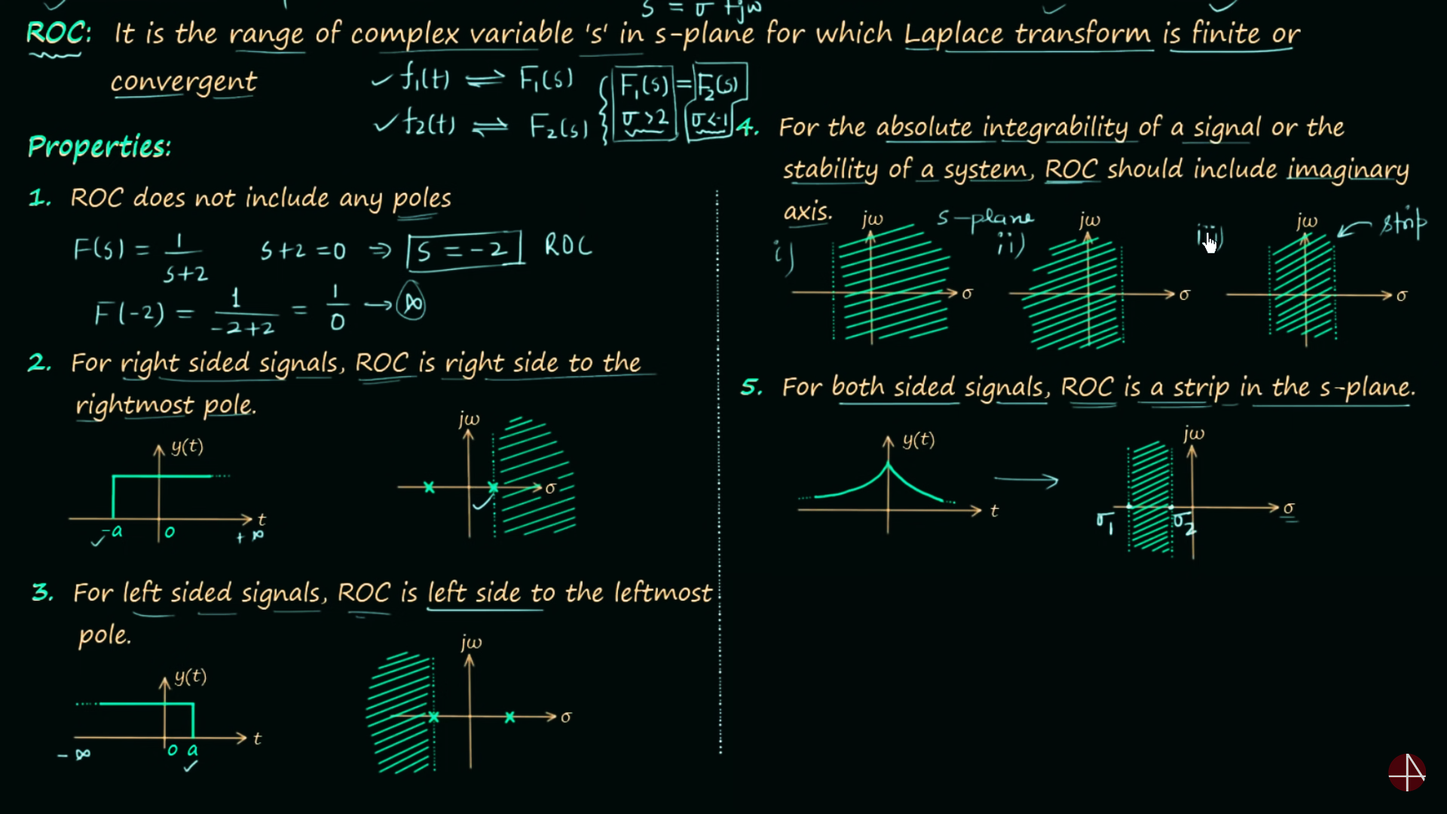
Properties of Region of Convergence (ROC)

Slide 12
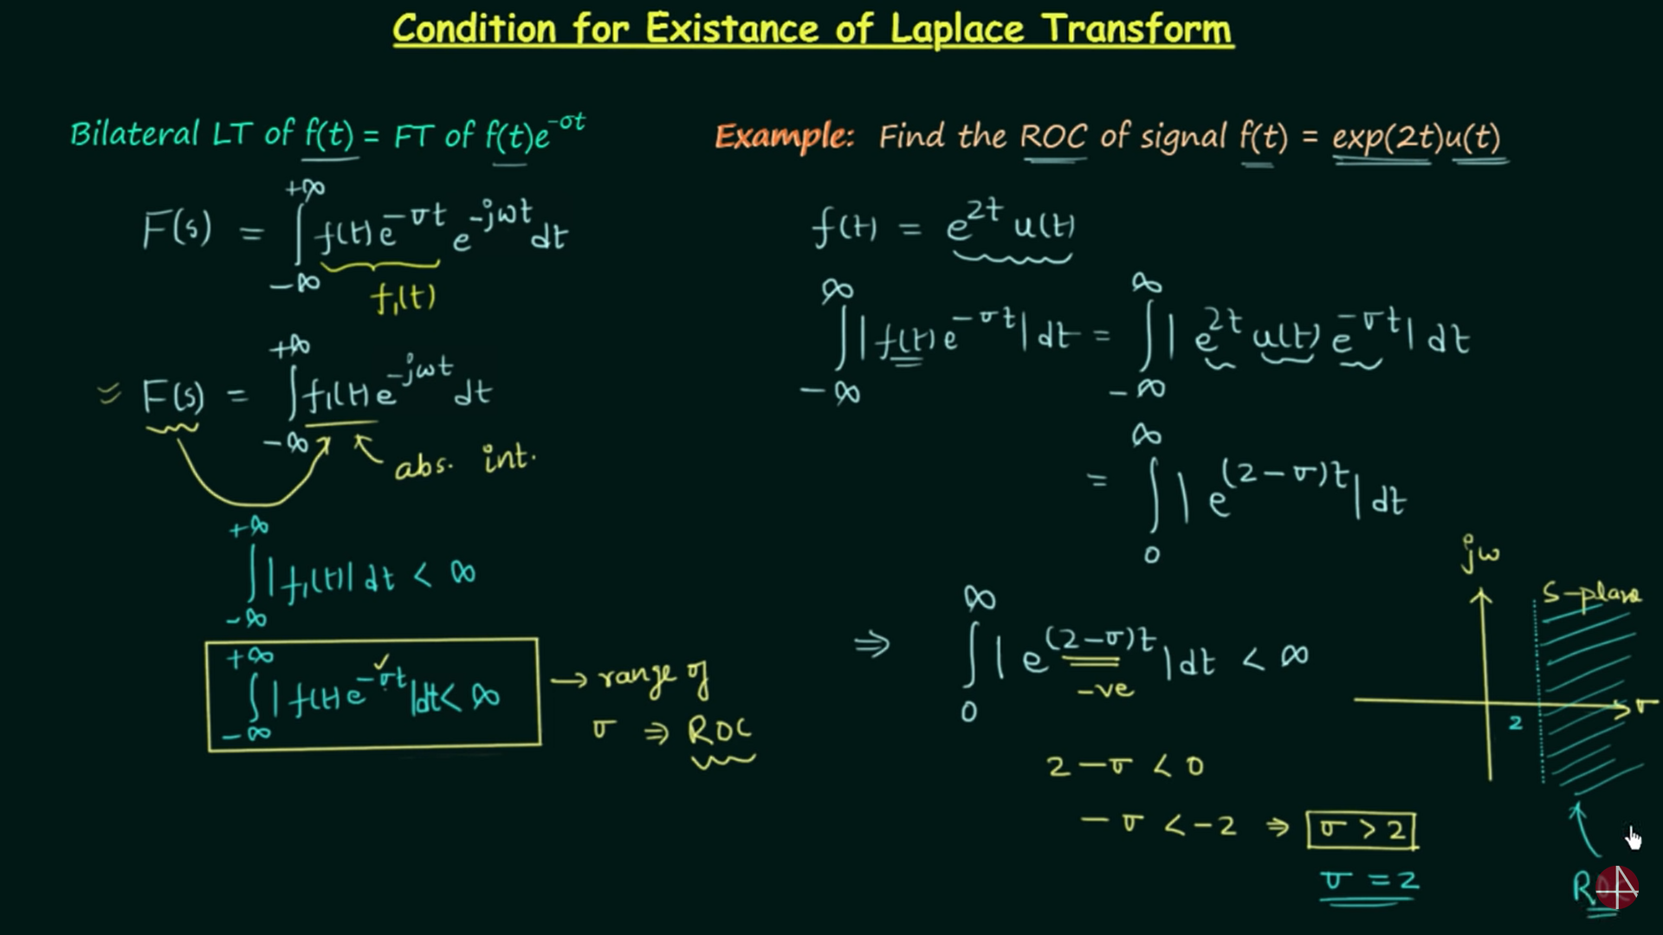
Region of Convergence (ROC)

Slide 13
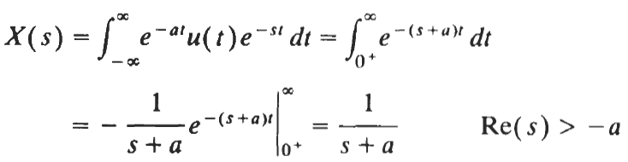
Region of Convergence (ROC)
Example:
Consider the signal x(t)=e^{-at}u(t) where a is real
According to the definition, the Laplace transform of x(t) is:
Because lim_{t->∞} e^{-(s+a)t}=0 only if Re(s+a)>0 or Re(s)>-a
Thus, the ROC for this example is specified as Re(s) >-a and is displayed in the complex plane as shown in Fig. 3-1 by the shaded area to the right of the line Re(s) =-a.
In Laplace transform applications, the complex plane is commonly referred to as the s-plane. The horizontal and vertical axes are sometimes referred to as the σ-axis and the jω-axis, respectively.

Slide 14
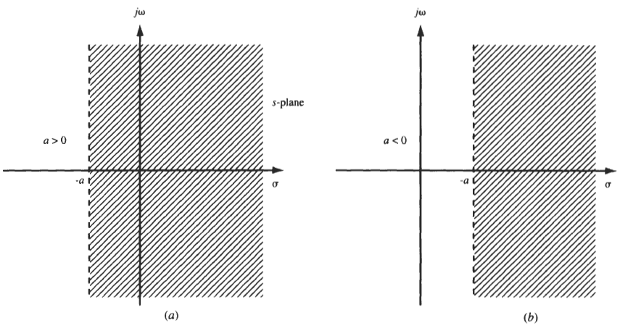
Region of Convergence (ROC)
Example-1:
Figure-3.1: ROC for example-1.

Slide 15
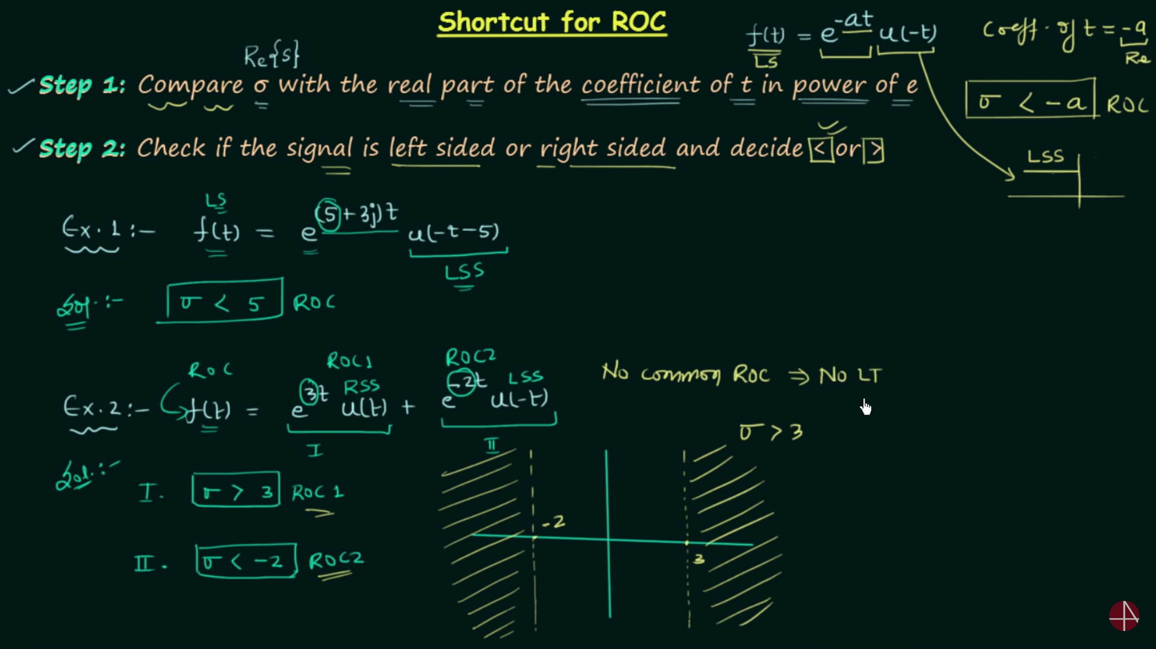
Region of Convergence (ROC)

Slide 16
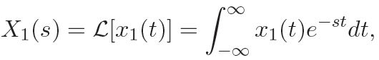
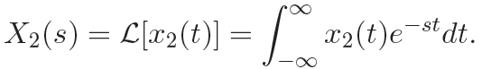
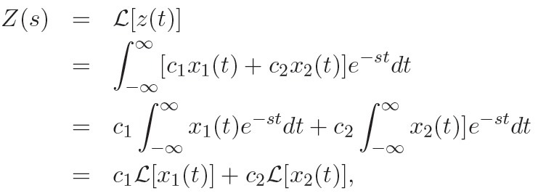
Properties of Laplace Transform
Linearity:
The Laplace transform of a linear combination of several functions is equivalent to the linear combination of the Laplace transforms of the individual functions.
and
Then, the Laplace transform of z(t) = c₁x₁(t) + c₂x₂(t) is:
and, thus, linearity of Laplace transform is established.
Notes:
Clearly the linearity property is very important as it can be used to break up the Laplace
transform of the linear combination of several functions to a linear combination of the Laplace
transforms of the individual functions. The ROC for the composite function is the intersection of
the ROCs for the individual functions.

Slide 17
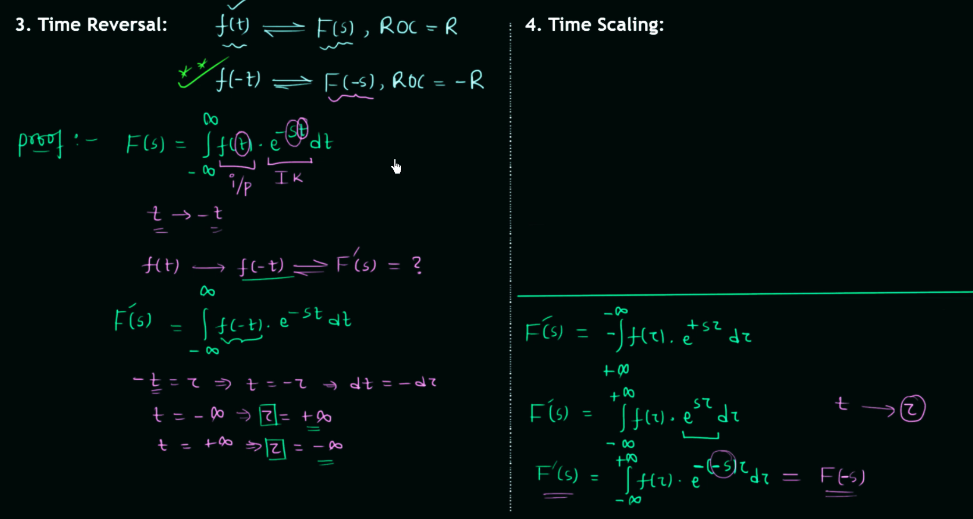
Properties of Laplace Transform

Slide 18
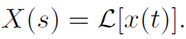
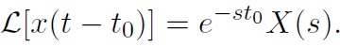
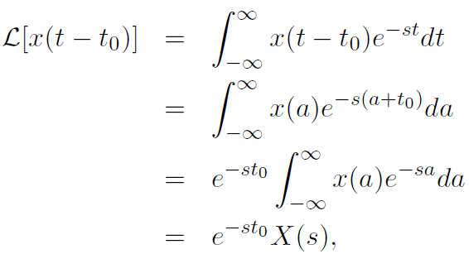
Properties of Laplace Transform
Time Shift:
Let
Then the Laplace transform of x(t - t₀) is
The proof is easily obtained from the definition of the Laplace transform and a simple change of variables by letting a=t-t₀.; thus, we have:

Slide 19
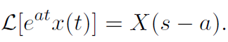
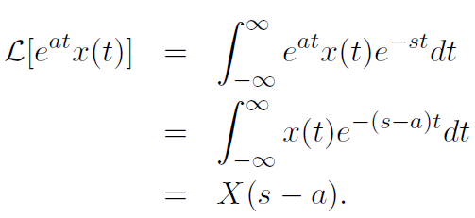
Properties of Laplace Transform
Frequency Shift:
Multiplication of signal x(t) by e^{at} in the time-domain corresponds to a frequency shift in the s-domain:
Proof:

Slide 20
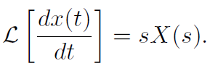
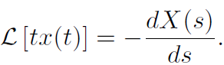
Properties of Laplace Transform
Time-domain Differentiation:
Differentiation of a signal x(t) in the time-domain corresponds to multiplication by s in the s-domain:
Frequency-domain Differentiation:
Multiplication of a signal x(t) by t in the time-domain corresponds to differentiation in the s-domain with negation:

Slide 21
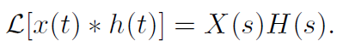
Properties of Laplace Transform
Convolution Property:
This is one of the most important properties of the Laplace transform as it pertains to the analysis and design of LTI systems.
This property states that convolution between two functions in the time domain corresponds to multiplication of their Laplace transforms in the s-domain.
Let h(t) and x(t) be two functions that have Laplace transforms H(s) and X(s) respectively. Then

Slide 22
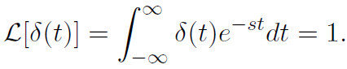
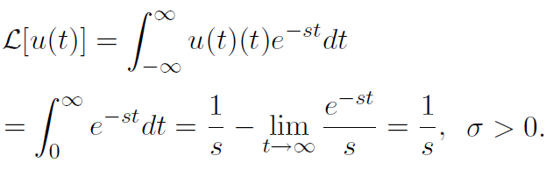
Laplace Transform of Some Useful Functions
Here we compute the Laplace transforms of some functions often encountered in the study of LTI systems.
The Laplace transform properties discussed above in conjunction with the Laplace transform of the functions given below can be used to obtain the Laplace transforms of a much larger variety of functions.
1. The Laplace transform of the delta function:
2. The Laplace transform of unit step function:

Slide 23
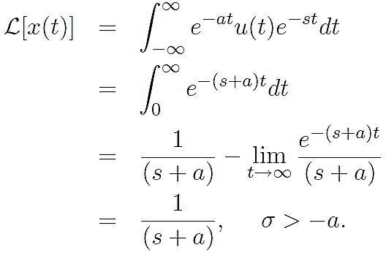
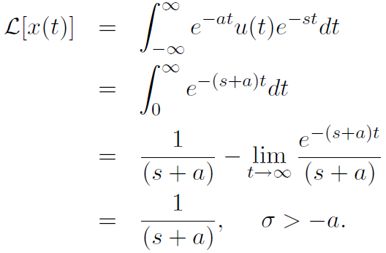
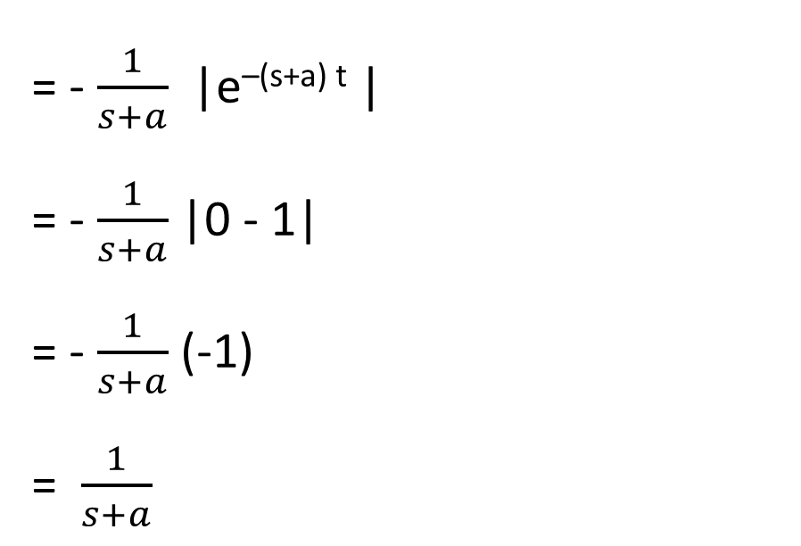
Laplace Transform of Some Useful Functions
3. The Laplace transform of x(t)= e^{-at}u(t):
= - $\frac{1}{s+a}$ |e^{–(s+a) t} |
= - $\frac{1}{s+a}$ |0 - 1|
= - $\frac{1}{s+a}$ (-1) = $\frac{1}{s+a}$

Slide 24
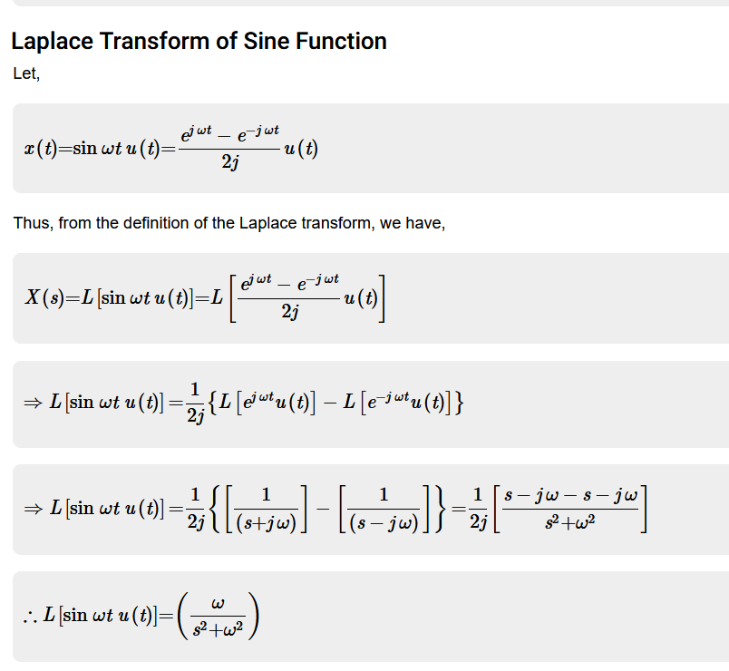
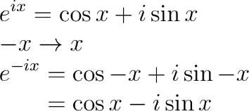
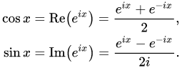
Euler’s Formula

Slide 25
Determining Laplace Transform
Computing Laplace transforms directly can be fairly complicated.
Usually we use a table of transforms along with the properties when computing Laplace transforms of a much larger variety of signals/functions.
The Laplace transform of most commonly used signals/functions often encountered in the study of LTI systems is given on the next slide. Some properties of Laplace transform are also given.

Slide 26
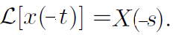
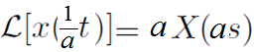
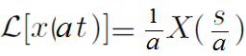
Formulas derived from the properties of Laplace Transform
Linearity:
If x(t) = c₁x₁(t) + c₂x₂(t), then:
X(s) = c₁X₁(s) + c₂X₂(s)
Time Shift:
If , then
Time Reversal:
If , then
Time Scaling:
If , then
Multiplication by time:
If , then

Slide 27
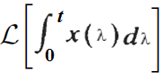
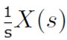
Formulas derived from the properties of Laplace Transform
Frequency Shift:
If , then
Convolution:
If x(t) = x₁(t) * x₂(t), then: X(s) = X₁(s) X₂(s)
Time-domain Differentiation:
If , then
Time-domain Integration:
If , then

Slide 28
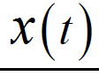
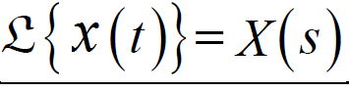
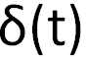
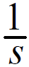
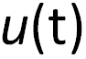
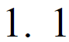
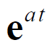
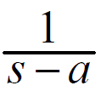
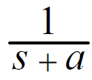
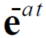
Laplace Transform of Some Useful Functions
1.
(Unit Impulse function)
2.
Or,
(Unit Step function)
3.
4.

Slide 29
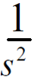
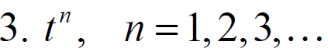




Laplace Transform of Some Useful Functions
5.
6.
7.
8.

Slide 30


Laplace Transform of Some Useful Functions
9.
10.
11.
12.

Slide 31



Laplace Transform of Some Useful Functions
13.
14.
15.
16.

Slide 32

Laplace Transform of Some Useful Functions
17.
18.
19.
20.

Slide 33

Determining Laplace Transform
Here we compute the Laplace transforms of some functions often encountered in the study of LTI systems.
Example-1:
Find the Laplace transform of the following function:
x(t)=6e^{-5t}+e^{3t}+5t³-9
Solution:
x(t)=6e^{-5t}+e^{3t}+5t³-9

Slide 34

Determining Laplace Transform
Example-2:
Find the Laplace transform of the following function:
f(t)=4cos(4t)-9sin(4t)+2cos(10t)
Solution:
f(t)=4cos(4t)-9sin(4t)+2cos(10t)

Slide 35

Determining Laplace Transform
Example-3:
Find the Laplace transform of the following function:
g(t)=3sinh(2t)+3sin(2t)
Solution:
g(t)=3sinh(2t)+3sin(2t)

Slide 36

Determining Laplace Transform
Example-4:
Find the Laplace transform of the following function:
h(t)=e^{3t}+cos(6t)-e^{3t} cos(6t)
Solution:
h(t)=e^{3t}+cos(6t)-e^{3t} cos(6t)

Slide 37

Determining Inverse Laplace Transform
Laplace transform converts a time-domain signal into s-domain. Inverse Laplace transform is used to determine time-domain signal from s-domain.
If Laplace transform of a time-domain signal x(t) is X(s), then inverse Laplace transform of X(s) is:
The key to doing inverse transforms is to look at the denominator (হর) and try to identify what you have got there.
If there is only one entry in the given problem that has a particular denominator, the next step is to make sure the numerator is correctly set up for the inverse transform process. If it is not, correct it and then take the inverse transform.
If there is more than one entry in the given problem that has a particular denominator, then the numerators of each will be different, so go up to the numerator and see which one you have got. If you need to correct the numerator to get it into the correct form and then take the inverse transform.
So, with this advice in mind let us see if we can take some inverse transforms.

Slide 38


Determining Inverse Laplace Transform
Example-1:
Find the inverse Laplace transforms of the function given below.
Solution:
From the denominator of the first term it looks that the first term is just a constant. The correct numerator for this term is a “1” so we will just factor the 6 out before taking the inverse transform.
The second term appears to be an exponential with a = 8 and the numerator is exactly what it needs to be.
The third term also appears to be an exponential and we will need to factor the 4 out before taking the inverse transforms.

Slide 39


Determining Inverse Laplace Transform
Example-2:
Find the inverse Laplace transforms of the function given below.
Solution:
The first term looks like an exponential with a=-2 and we will need to factor out the 19.
The second term almost looks like an exponential, we have to factor the 3 out of the denominator since it can’t be there for the inverse transform.
The denominator of the third term appears to be in the table with n=4. The numerator however, is not correct for this. There is currently a 7 in the numerator and we need a 4! = 24 in the numerator. This is very easy to fix. Whenever a numerator is off by a multiplicative constant, all we need to do is put the constant that we need in the numerator. We will just need to remember to take it back out by dividing by the same constant.

Slide 40

Determining Inverse Laplace Transform
Example-3:
Find the inverse Laplace transforms of the function given below.
Solution:
Here, the denominator in both terms are same. The first term has an s in the numerator. We need to factor the 6 out of the numerator.
The second term has only a constant in the numerator and we need to multiply/divide a 5 in the numerator to get it correct for the table.

Slide 41

Determining Inverse Laplace Transform
Example-4:
Find the inverse Laplace transforms of the function given below.
Solution:
The first term will be a sine once we factor a 3 out of the denominator, while the second term appears to be a hyperbolic sine.

Slide 42
Applications of Laplace Transform
Applications of Laplace Transform
Analysis of electrical and electronic circuits.
Breaking down complex differential equations into simpler polynomial forms.
Laplace transform gives information about steady as well as transient states.
In machine learning, the Laplace transform is used for making predictions and making analysis in data mining.
Laplace transform simplifies calculations in system modeling.

Slide 43
Applications of Laplace Transform
Application of Laplace Transform In Signal Processing
Laplace transforms are frequently opted for signal processing. Along with the Fourier transform, the Laplace transform is used to study signals in the frequency domain. When there are small frequencies in the signal in the frequency domain then one can expect the signal to be smooth in the time domain. Filtering of a signal is usually done in the frequency domain for which Laplace acts as an important tool for converting a signal from time domain to frequency domain.
Application of Laplace Transform In Control Systems
Control systems are usually designed to control the behavior of other devices. Example of control systems can range from a simple home heating controller to an industrial control system regulates the behavior of machinery. Generally, control engineers use differential equations to describe the behavior of various closed loop functional blocks. Laplace transform is used here for solving these equations without the loss of crucial variable information.

Slide 44
Thank You

